Slide 1
The project: “ Welcome to our school website”
Fatima Manafova
(5th form)
School № 16

Slide 2
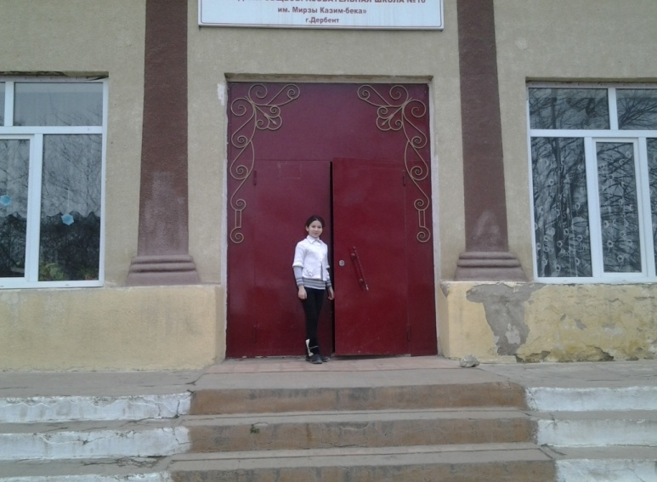
Welcome to our school website
Secondary School №16
Derbent, Daghestan
About us
School life
English classes
Contact us.
Hello! My name is Fatima. I am a fifth form pupil of School №16. I invite you to visit our new school website. The address of school website is – www. Derbent school № 16.ru. Here you can find information about our school, our teachers, pupils, our English classes, school holidays and events. You can see a lot of interesting photos. I hope you will be glad to visit us.

Slide 3
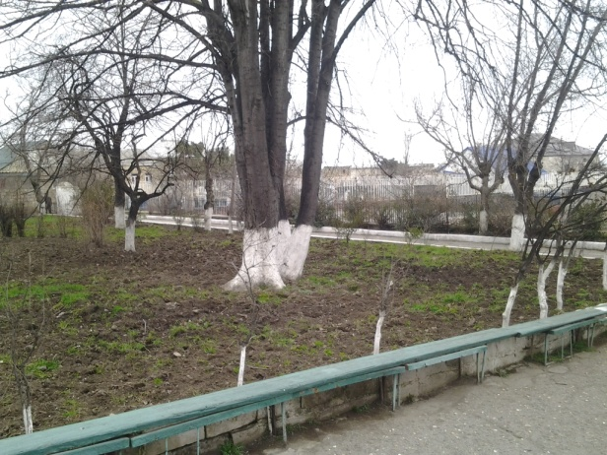
About us.
This is our school. It was built many years ago. It is old, but cosy and nice. Our school is two storeyed building. There are a lot of light classrooms here. We have a nice schoolyard with a lot of trees and a playground.

Slide 4
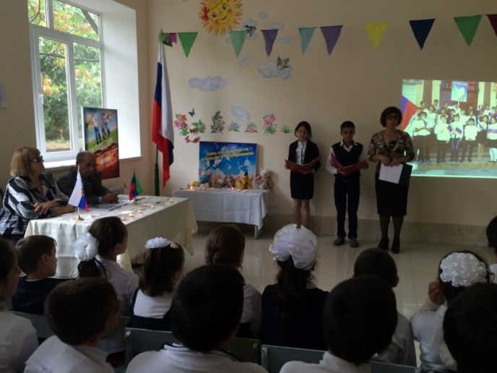
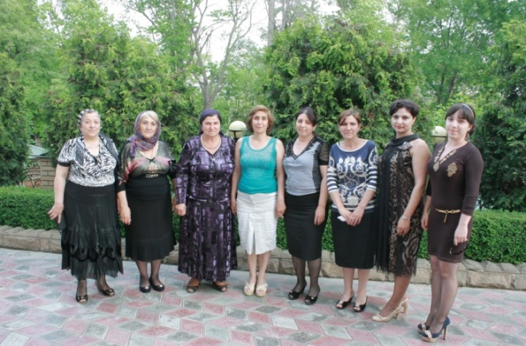
About us.
Teachers.
Students.
Here you can see our head teacher, teachers, our pupils and their parents.

Slide 5
About us.
These are the pupils of our class with our teacher during the holiday about autumn.
Teachers.
Students.

Slide 6
School life.
We learn different subjects at school. My favorite subject is English. I enjoy reading stories and learning poems in English.
Subjects.
Timetable.
School rules.
After school activities.

Slide 7
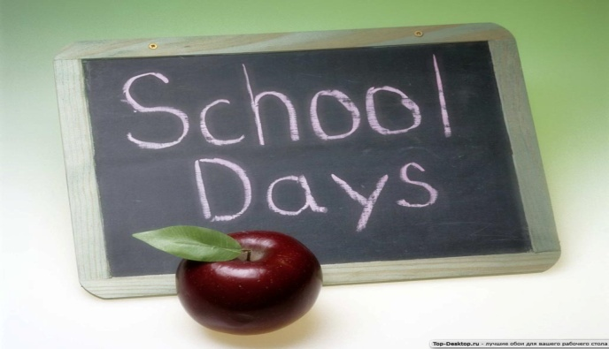
School life. This is our timetable.
Monday | Tuesday | Wednesday | Thursday | Friday | Saturday
1. Music. | 1. Art. | 1. Maths. | 1. Literature. | 1. Russian | 1. Russian.
2. English. | 2. Maths. | 2. History. | 2. Russian. | 2. Nature studies. | 2. English.
3. Maths. | 3. Russian. | 3. English. | 3. Maths. | 3. Maths. | 3. Mother tonger.
4. Russian. | 4. History. | 4. Technology. | 4. PE. | 4. Russian. | 4. Technology.
5. Literature. | 5. Nature studies. | 5. PE. | 5. Mother tonger. | 5. PE.
6. Mother tonger. |  |  |  | 6. Literature.

Slide 8
School life.
School rules for teachers.
School rules for students.
Enjoy learning English!
Learn hard!
Don’t fight with your classmates.
Make your teacher happy.
Be polite, active and creative.
Always do your homework.
Don’t write on the desks.
Make your students happy.
Give only good marks.
Do not give any homework.
Be kind and friendly.

Slide 9
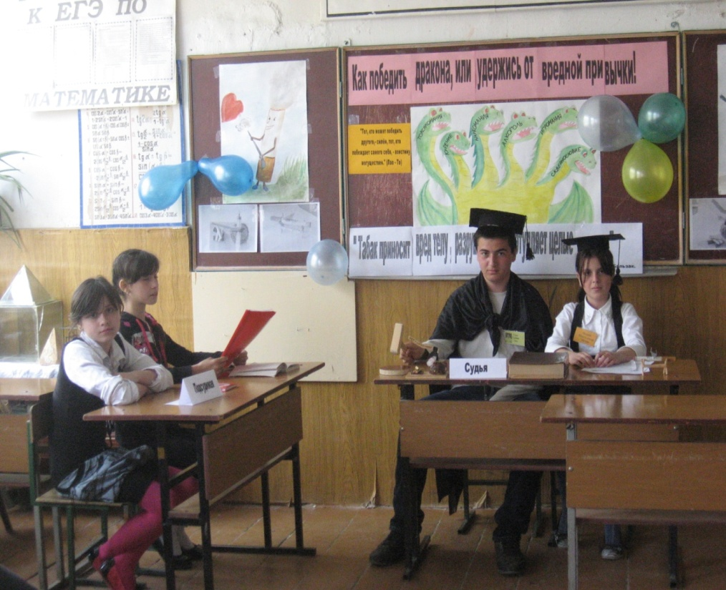
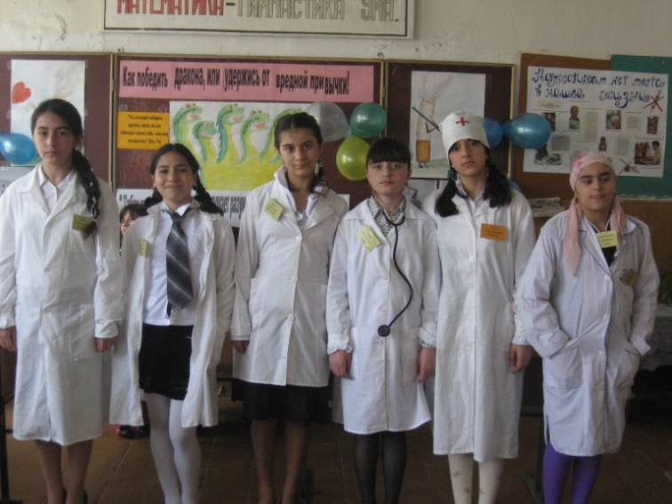
After school activities.
School life in photos.

Slide 10
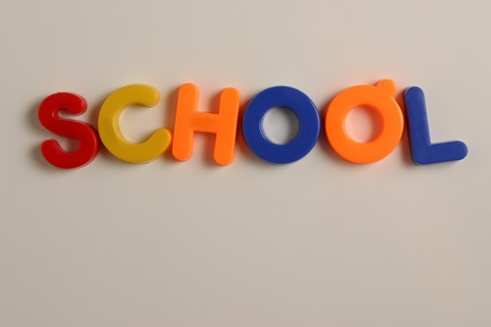
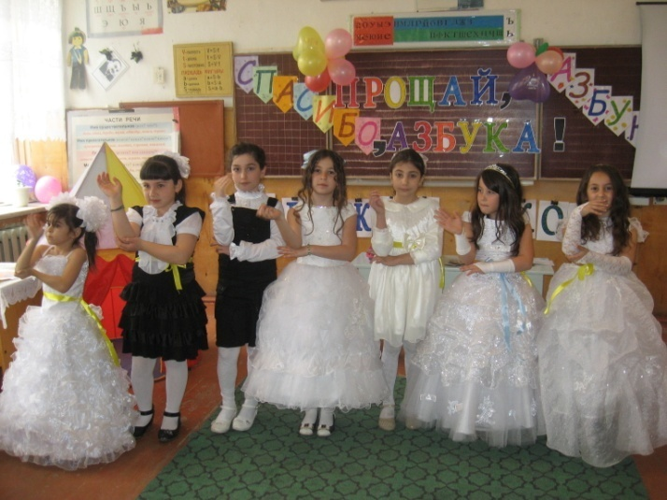
School life in photos.

Slide 11
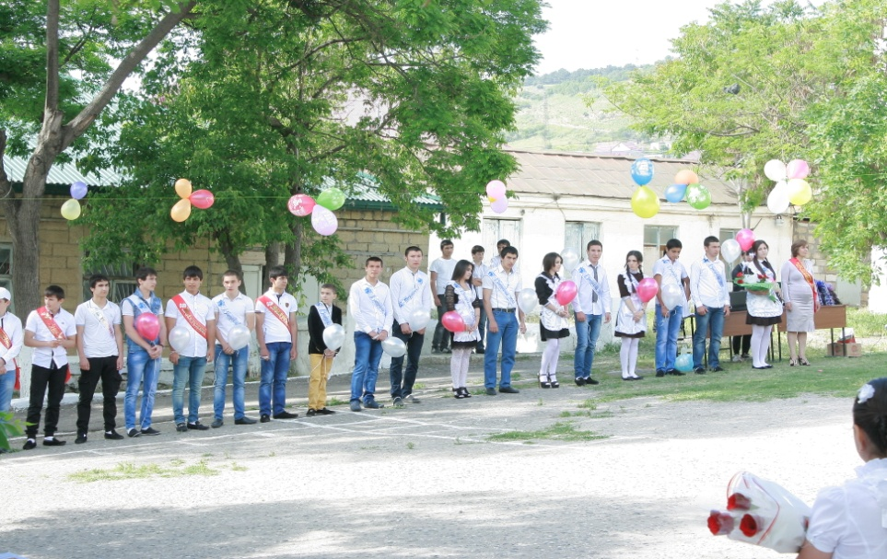
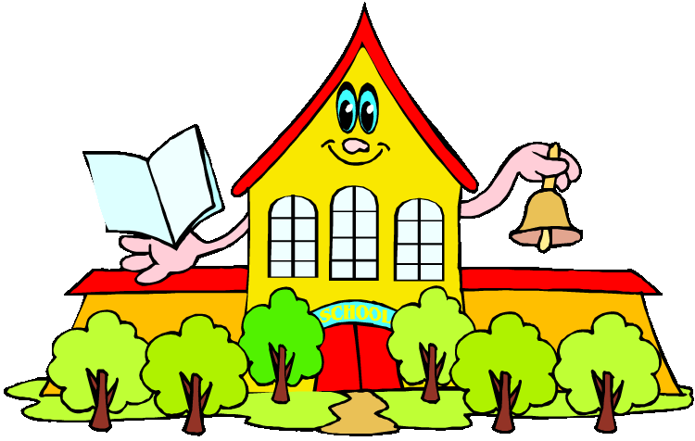
School life in photos.
These are the photos of our last school bell.

Slide 12
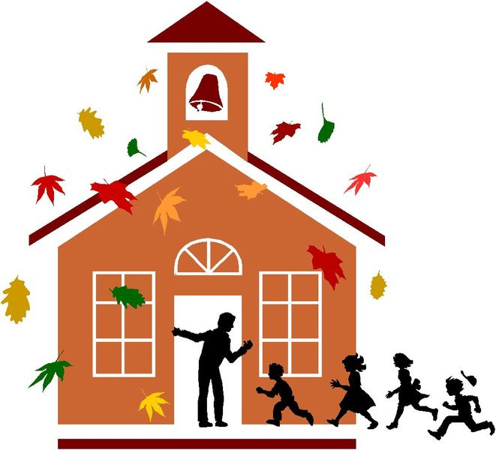
English classes.
Our English lessons and parties.

Slide 13
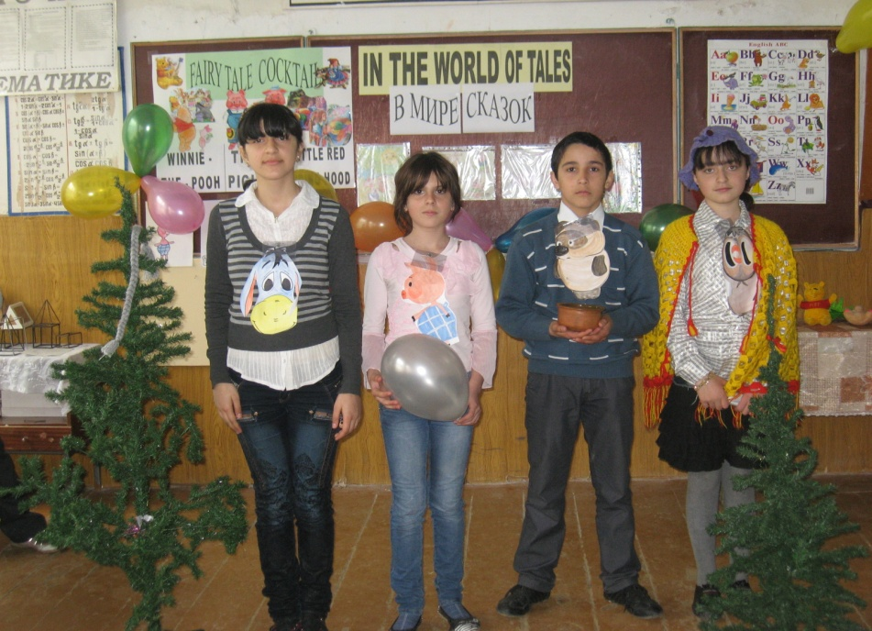
English classes.
Our English lessons and parties.

Slide 14
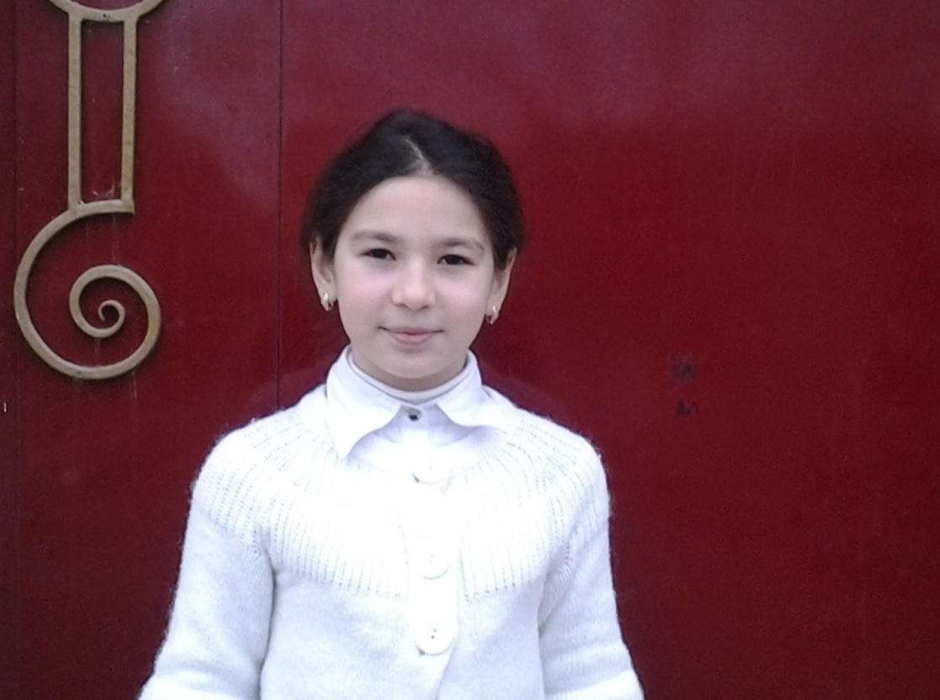
Contact us.
The author of this project:
Fatima Manafova (5th form)
Address:
103, Lenin Street,
Derbent, Daghestan.

